Slide 1
Declaration on the Rights of Deaf Children
A perspective by deaf teachers:
Rachelle Stevens and Elizabeth Reed
National Week of Deaf People September 2023

Slide 2
Acknowledgement of Country
Notes:
We acknowledge Aboriginal and Torres Strait Islander people as the first peoples and Traditional Owners and custodians of the land and waterways on which we live. We honour and pay our respects to Elders past and present and those who are watching us tonight.

Slide 3
Acknowledgement of Deaf Space
Notes:
From Deaf Australia: We acknowledge and respect the members of the Deaf Community in Australia, who preserve their rich heritage, culture and our language; Auslan (Australian Sign Language). We also acknowledge our custodians of Auslan, promoting awareness, equality and access through our sign language. Through Auslan, we inspire future leaders in our deaf community to continue our legacy and heritage.

Slide 4
Personal & Professional Introductions
Rachelle Stevens (Shel)
Elizabeth Reed (Liz)
Notes:
Briefly talk about where we work, our roles within the workplace (Primary, Secondary, leadership etc), deaf teachers and deaf all our lives
(remember majority of people watching may be parents and teachers)
5 minutes

Slide 5
Notes:
Why did we attend the 19th World Congress of WFD in Jeju this year? What fueled our decision?
5 minutes

Slide 6
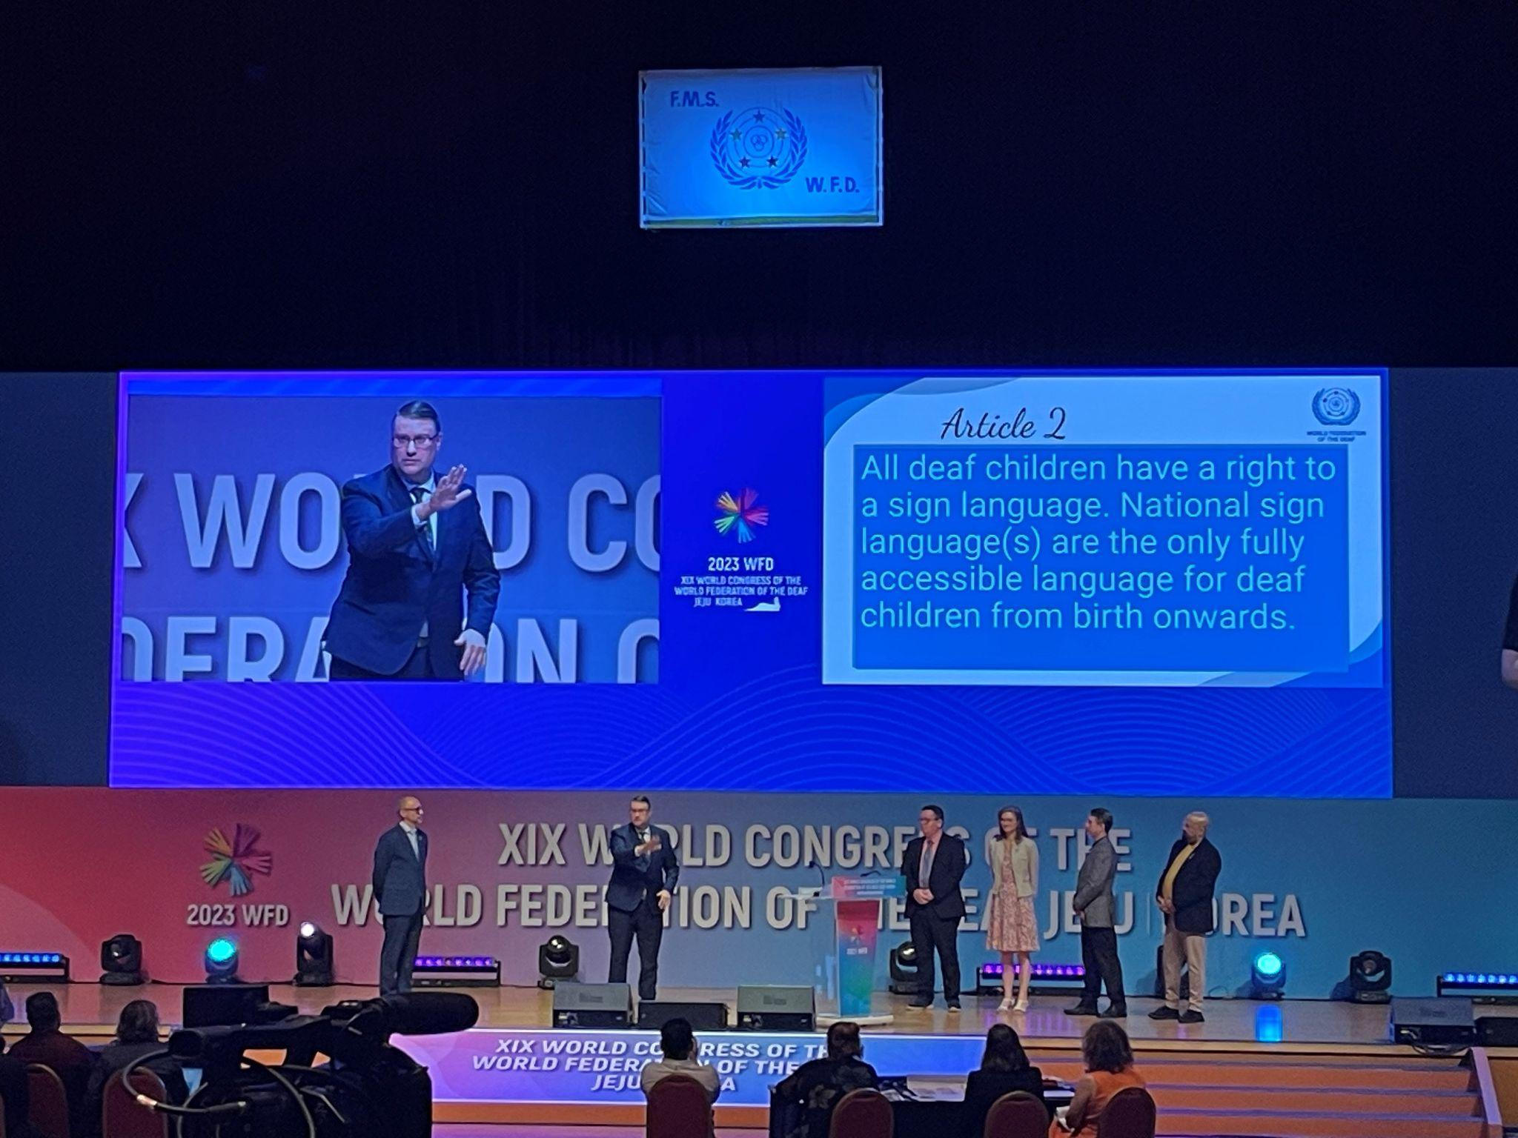
Notes:
What was it like when Dr Joseph Murray declared the Rights of Deaf Children? What was the atmosphere like? How did we personally react (tears!)
5 minutes

Slide 7
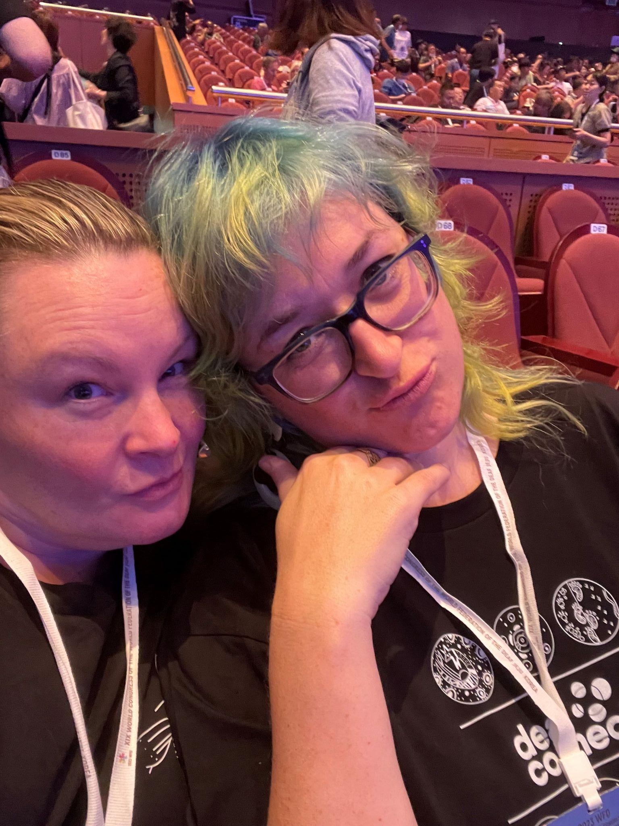
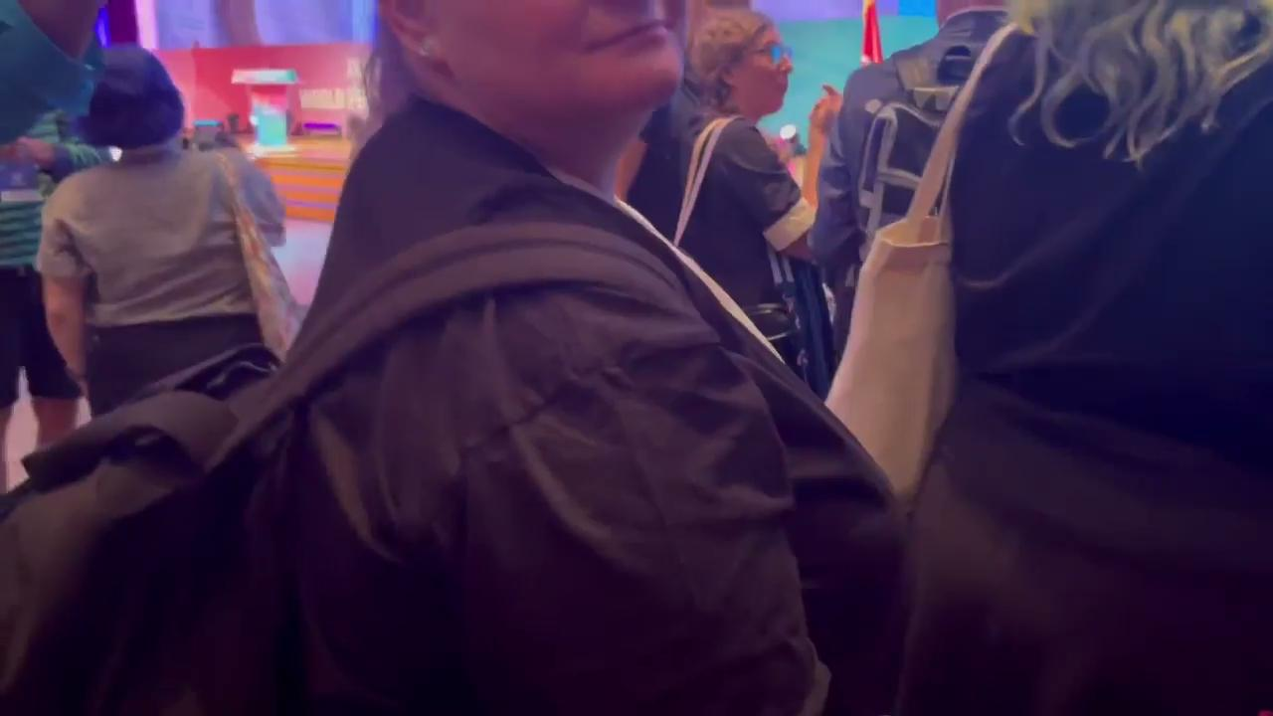
Notes:
Before and After the declaration - we had no idea prior, and our emotions were at an all-time high after.
5 minutes

Slide 8
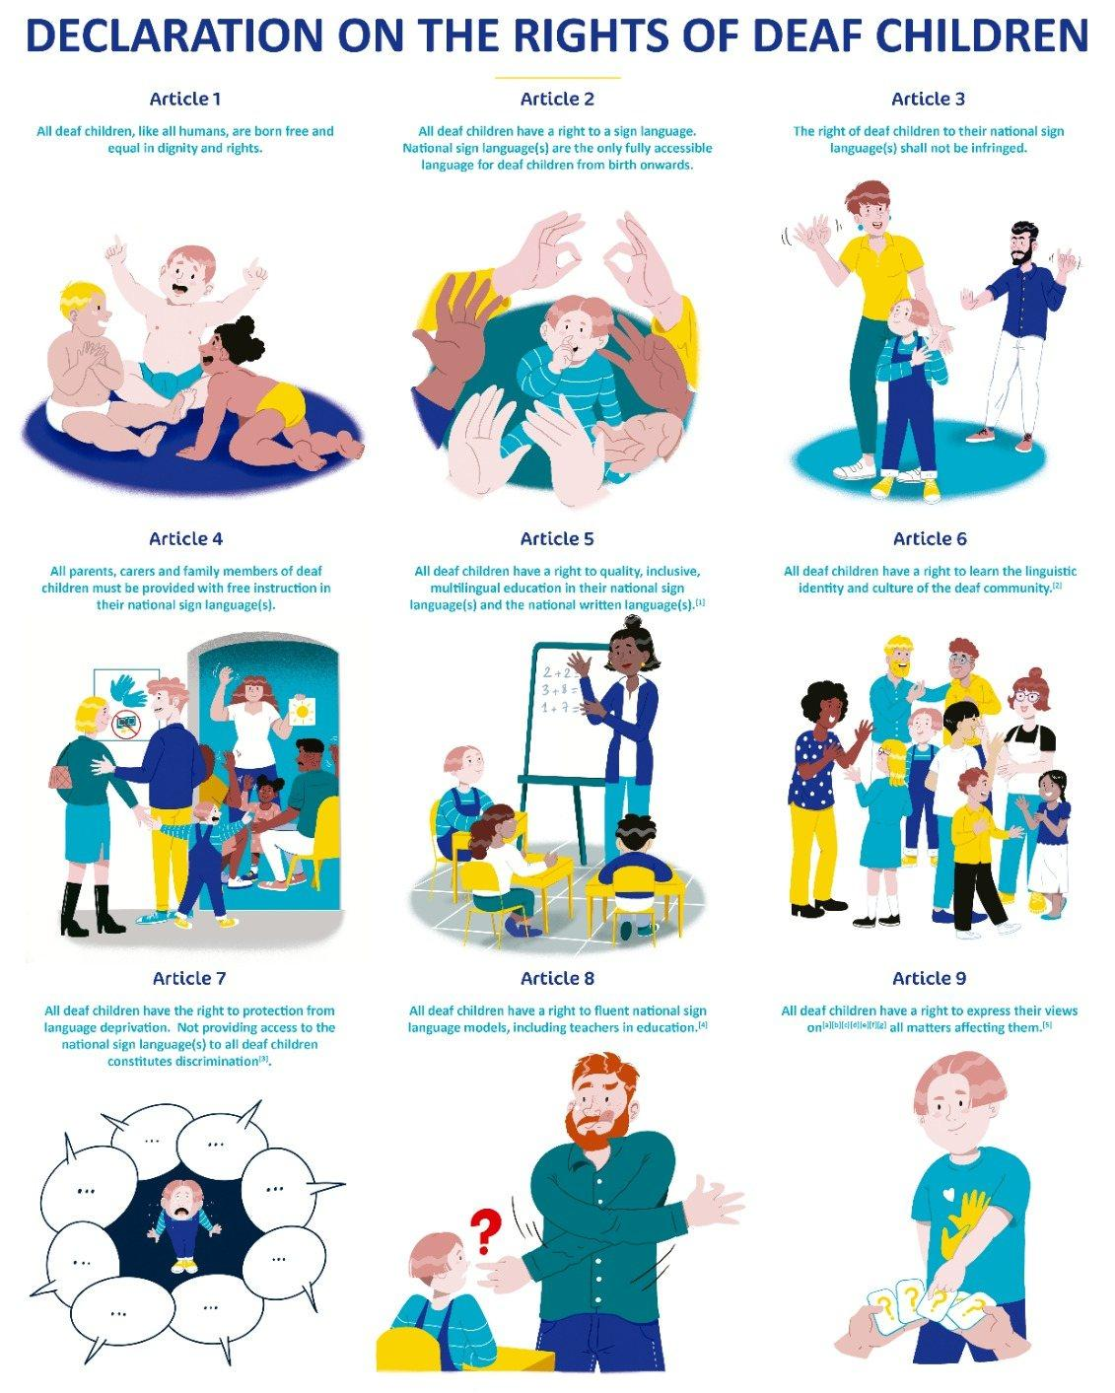
Notes:
Each WFD board member went on stage and translated each article. We will unpack each article and link it to deaf education in Australia.
(Slides 6 to 16 - total: 20 minutes)

Slide 9
Notes:
Unpacking this: slowly but surely, UN is recognising that deaf children are unique from hearing children and have distinct needs that cannot be enveloped in a general “inclusive” approach. Every deaf baby is individual but a baby first before their deafness with core needs just like a hearing baby, however their pathway to learning and accessing language differ. This does not mean they are any different or of lesser value, just unique!

Slide 10
Notes:
Unpacking this: more research shows that deaf children, no matter their communication pathway, benefits from having sign language access from day one. Look at the situation in South Australia’s cochlear implant clinic - over a hundred deaf children affected by cochlear implant bungling, and the families who employed Auslan from day one are breathing a sign of relief. Of course, we as teachers acknowledge the stress this would have caused the families but we are showing from our perspective of how important language access is. Technology aids and implants are not accessible from day 1; only sign language is - and we don’t know whether technology will be successful until much later, while sign language has evidence from the beginning that matches development milestones of children.

Slide 11
Notes:
Unpacking this: this means that a deaf child deserves access to the national sign language, which should not be substituted by ‘baby signs’, cued signs, signed english, total communication and other systems that have failed in their repeated attempts to replace or work alongside the national sign language. Add in that all those attempts have been perpetuated by hearing teachers/educational researchers with no direct involvement in the deaf community, and not deaf teachers/educational researchers or being exposed to deaf role models in the community - we have lots of them around and sometimes they are the best models that can offer so much in a neutral environment that is comfortable for the family. This is where access to language does not need to be “infringed”.

Slide 12
Notes:
Unpacking this: Australia falls slightly behind some countries such as Sweden where sign language classes are compulsory for parents and carers, even if they wish to raise their deaf children orally. This is funded by the government and parents can apply for funding to continue past the compulsory 60-70 hours. In Australia, we now have NDIS but the process can be cumbersome and often difficult to find instructors or classes. Elizabeth: my school provides Family Auslan, designed to give a safe space for parents/carers to learn Auslan in a family context - many of them find TAFE certificate classes intimidating and not flexible enough for them. Rachelle: my school offers Auslan family classes as well as Auslan classes for our bus staff on a weekly basis over a few weeks both online and in person. There needs to more classes made available specifically for that demographic, rather than people who are interested in Auslan causally or professionally. There is evidence that people will commit to classes if they are short term, rather than a fixed long term (i.e. 6 months, or a year). We both acknowledge the demand is much higher than the supply these days, and we are hoping to see a solution to this in the near future.

Slide 13
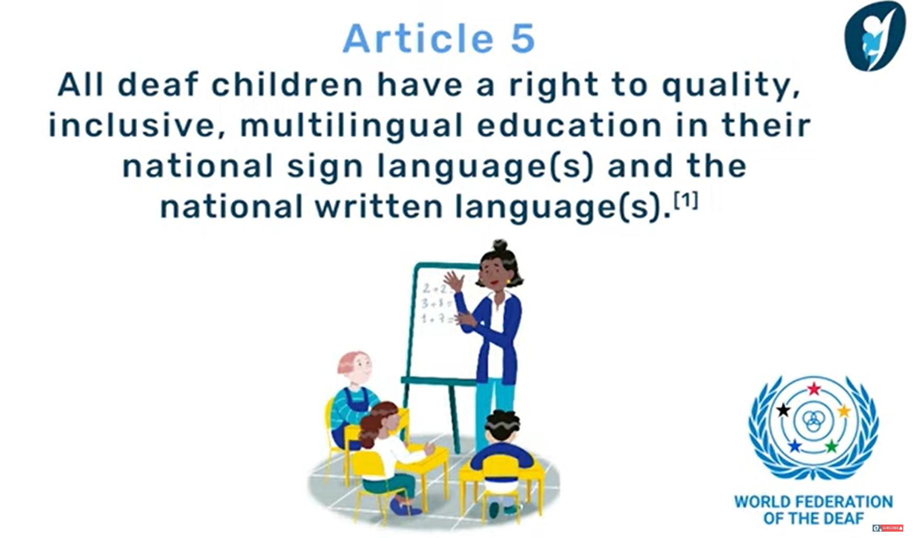
Notes:
Unpacking this: This is the most contentious article - at present, deaf schools and facilities are being closed at a increasing rate not just in Australia, but globally. There are now only two deaf schools in Australia - Victorian College for the Deaf and Furlong Park for Deaf Children. We acknowledge there is Aurora School also in Victoria that specialises in early intervention and first year of schooling. VCD caters for Primary to Secondary, while Furlong Park caters for children from 3 to 12 years old with an early education program and a primary school setting.
In 1946, there was the infamous Ewing report where two hearing consultants from England, advocating the oral method, travelled around Australia visiting deaf institutions (and interestingly, ignoring Victoria) and gave advice to the government to close deaf schools and facilities, minimising access to deaf education for deaf children. Then in the 90s, Reasonable Adjustment was introduced to give deaf children access to nearby schools so that they could go to the same school as their siblings or walk there, instead of taking taxis or long journeys to deaf schools/facilities. However, this means stretching deaf teachers, educational interpreters and support across several school settings. There is a nationwide shortage of qualified teachers who are equipped to work with deaf and hard of hearing children of all ages.
The [1] foot note refers back to Article 1, which says that deaf children are born free and equal to hearing children.

Slide 14
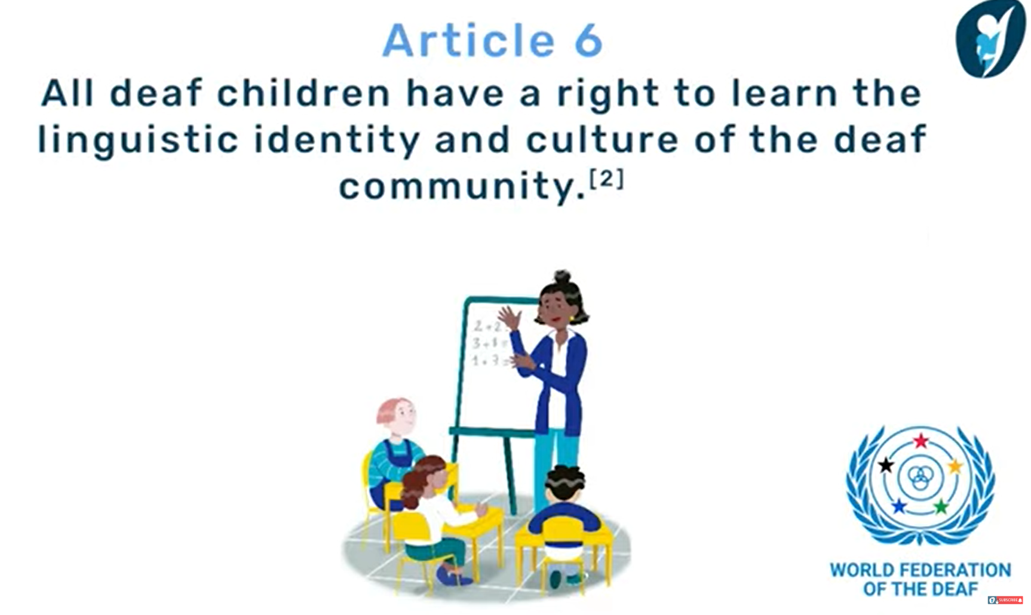
Notes:
Unpacking this: this can be difficult for parents and carers to participate in the deaf community on behalf of their deaf child; many have their own community and cultural identities, and it is critical for their children to learn that too. Navigating a new community can be intimidating and overwhelming, on top of limited access and information for children-friendly events. As teachers, we understand the frustration; deaf schools and facilities are often far away from students’ homes, making it difficult to establish a rich parent community where resources and information can be shared, overlapping with the deaf community. At both schools, we provide a bilingual and bicultural approach to the children’s learning so they can develop their own individual identities and one that enables them to intertwine and embrace with their personal beliefs (from home). This is where NDIS could be used creatively by utilising role models to allow the deaf children to build a strong sense of belonging in both communities.

Slide 15
Notes:
Unpacking this - language deprivation: ask any deaf educational professional and they will tell you, language deprivation is where all the issues spring from, and the whole purpose of deaf education. Unfortunately, language deprivation still occurs nationwide in Australia. Referring back to the South Australia cochlear implant clinic incident - it would be fair to say that the children affected are at a higher risk of language deprivation now. Language deprivation cannot be fully eliminated as deaf children do not access to ‘incidental learning’ which is immersion in language from different sources, such as radio/television, adult conversations, subtleties in speech tones, and more. But it can be reduced.
Today, the issue is that many medical professionals and speech pathologists do not always unpack language deprivation and offer sign language as a viable pathway - some of them even suggest that sign language detracts from speech, a myth that is difficult to bust. It is good to see an increase of allied health professionals acknowledging the benefits of using Auslan and learning the language now.

Slide 16
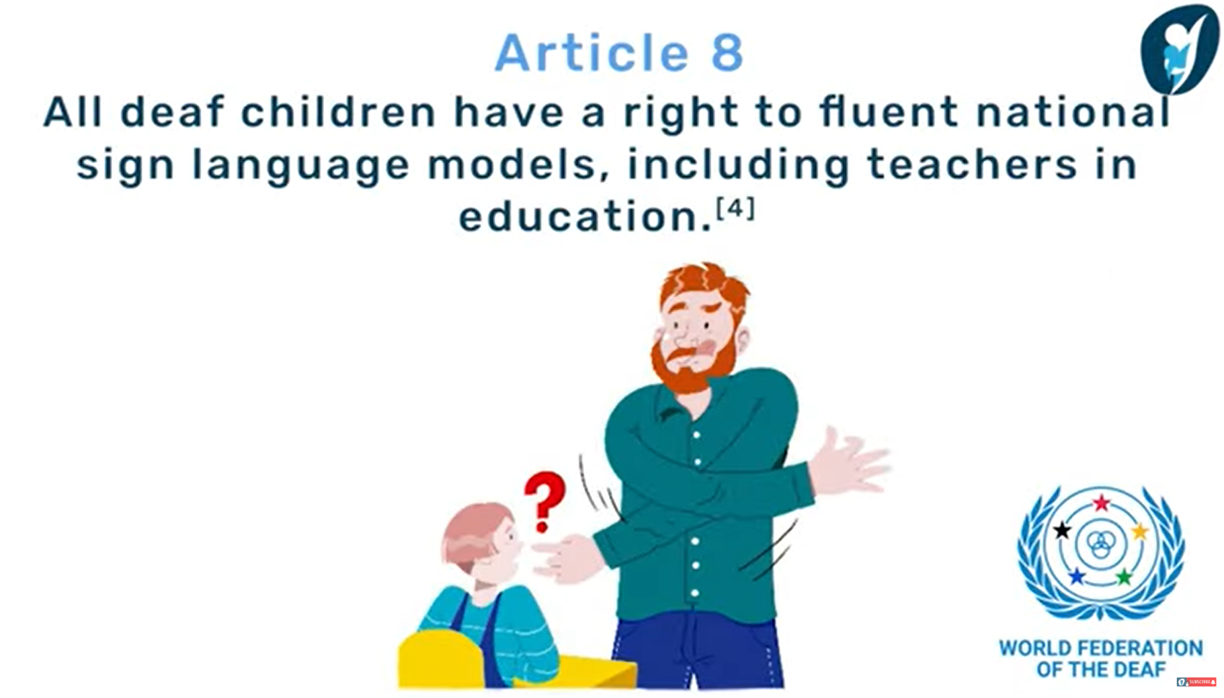
Notes:
Unpacking this - referring back to Article 4; the right to inclusive, multilingual education. As we mentioned, deaf educators and interpreters are being stretched thin across several school settings. Visiting teachers are one approach, but again, their capacity is being stretched in that they are visiting several schools in one week - and not all of them are fluent in Auslan. So a deaf child enrolled in a mainstream school with educational interpreters faces several risks from their interpreter being absent and irreplaceable, having a visiting teacher who is not fluent in Auslan visiting once every fortnight or even termly and for a very limited time. Queensland has established ALMs - Auslan Language Models - that is having some success in ensuring that children have regular access to deaf models within schools and having education interpreters in the classroom also. They both have distinct roles within the classroom. In Victoria, it all comes down to funding - educational interpreters are not as paid as much as freelance interpreters despite doing the same requirements to become an Auslan interpreter. Then again, schools may employ education support to have a dual purpose in interpreters do not require NAATI certification, which runs the risk of acting as inappropriate language models for deaf children.
This is something that needs to be looked at and immediately for deaf children to have access to appropriate models to access Auslan.

Slide 17
Notes:
Unpacking this: This is a difficult topic as deaf children may not have the language or capacity for self-advocacy, nor do they have access to information or experiences to make informed decisions. There are groups who believe that deaf children should be given the opportunity to decide whether they want to receive an implant, which means not implanting at an early age. Other groups believe that deaf children should be implanted as early as possible to avoid auditory neuropathy and thus given access to sound and speech, giving them additional opportunities. We as teachers acknowledge this, however the missing piece to this is accessing language from day one. The fact is this: many deaf adults appreciate having access to sign language, and wish that they had it from an early age. Personally - we have students, who struggled in oral education for years arrive at our schools, only to pick up sign language at light-speed and thrive. We never hear of anyone saying they regret learning sign language, however we do hear of many stories from families regretting their decision of not learning Auslan earlier for their deaf child.

Slide 18
Notes:
Unpacking this: We have delved each article of the Rights of the Deaf Child and given you a compressed definition, however each article can be interpreted in many ways and would raise lots of questions with no answers. Each deaf child is unique, with individual access requirements that need to be acted on immediately, from the moment of diagnosis. This would also mean early access to early intervention programs with support and providing families with authentic, evidence-based information. We usually say that Parents and caregivers know their child best, however when provided with the right resources and guidance, this could make the world of difference for their deaf child when it comes to language development which in turn would make the deaf child and their family experience a more positive journey together.

Slide 19
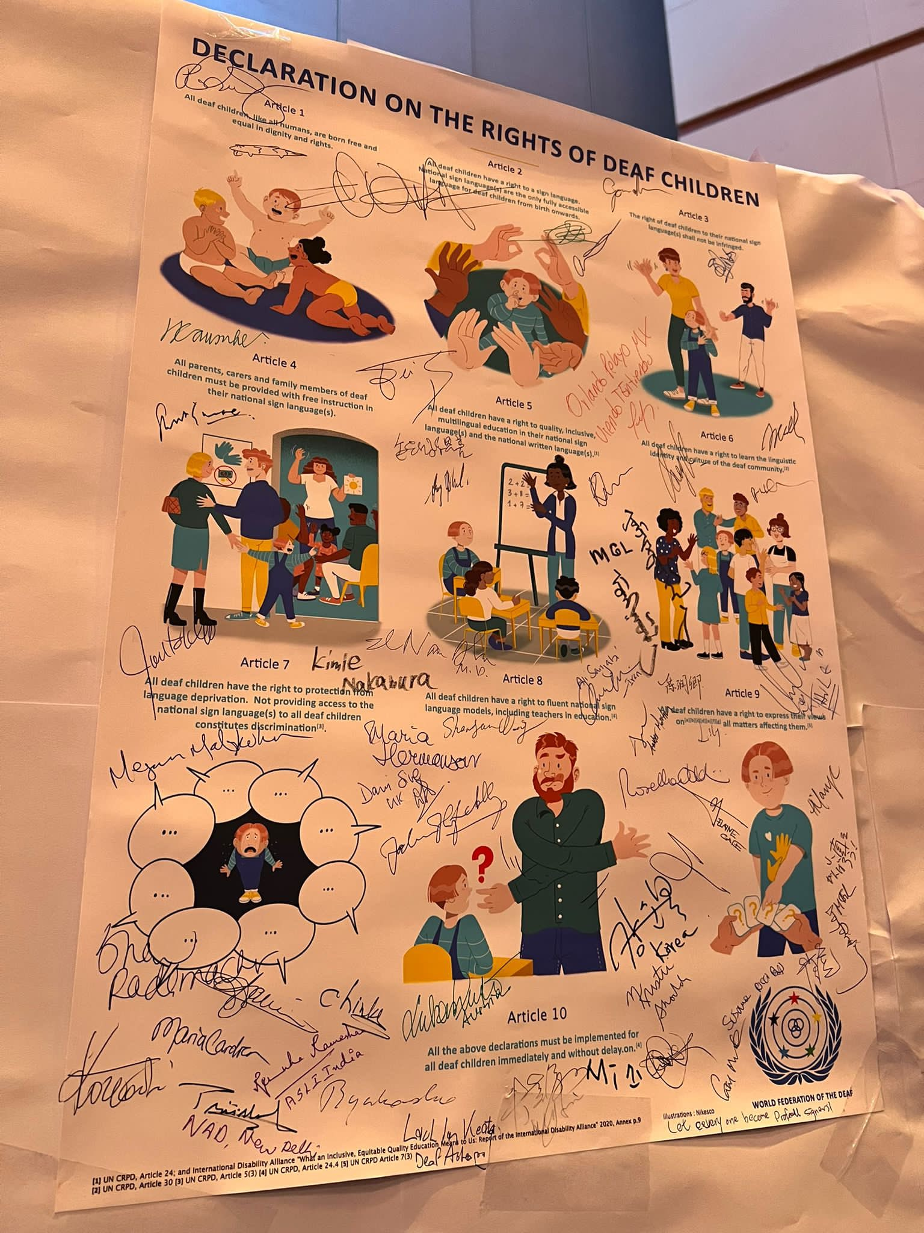
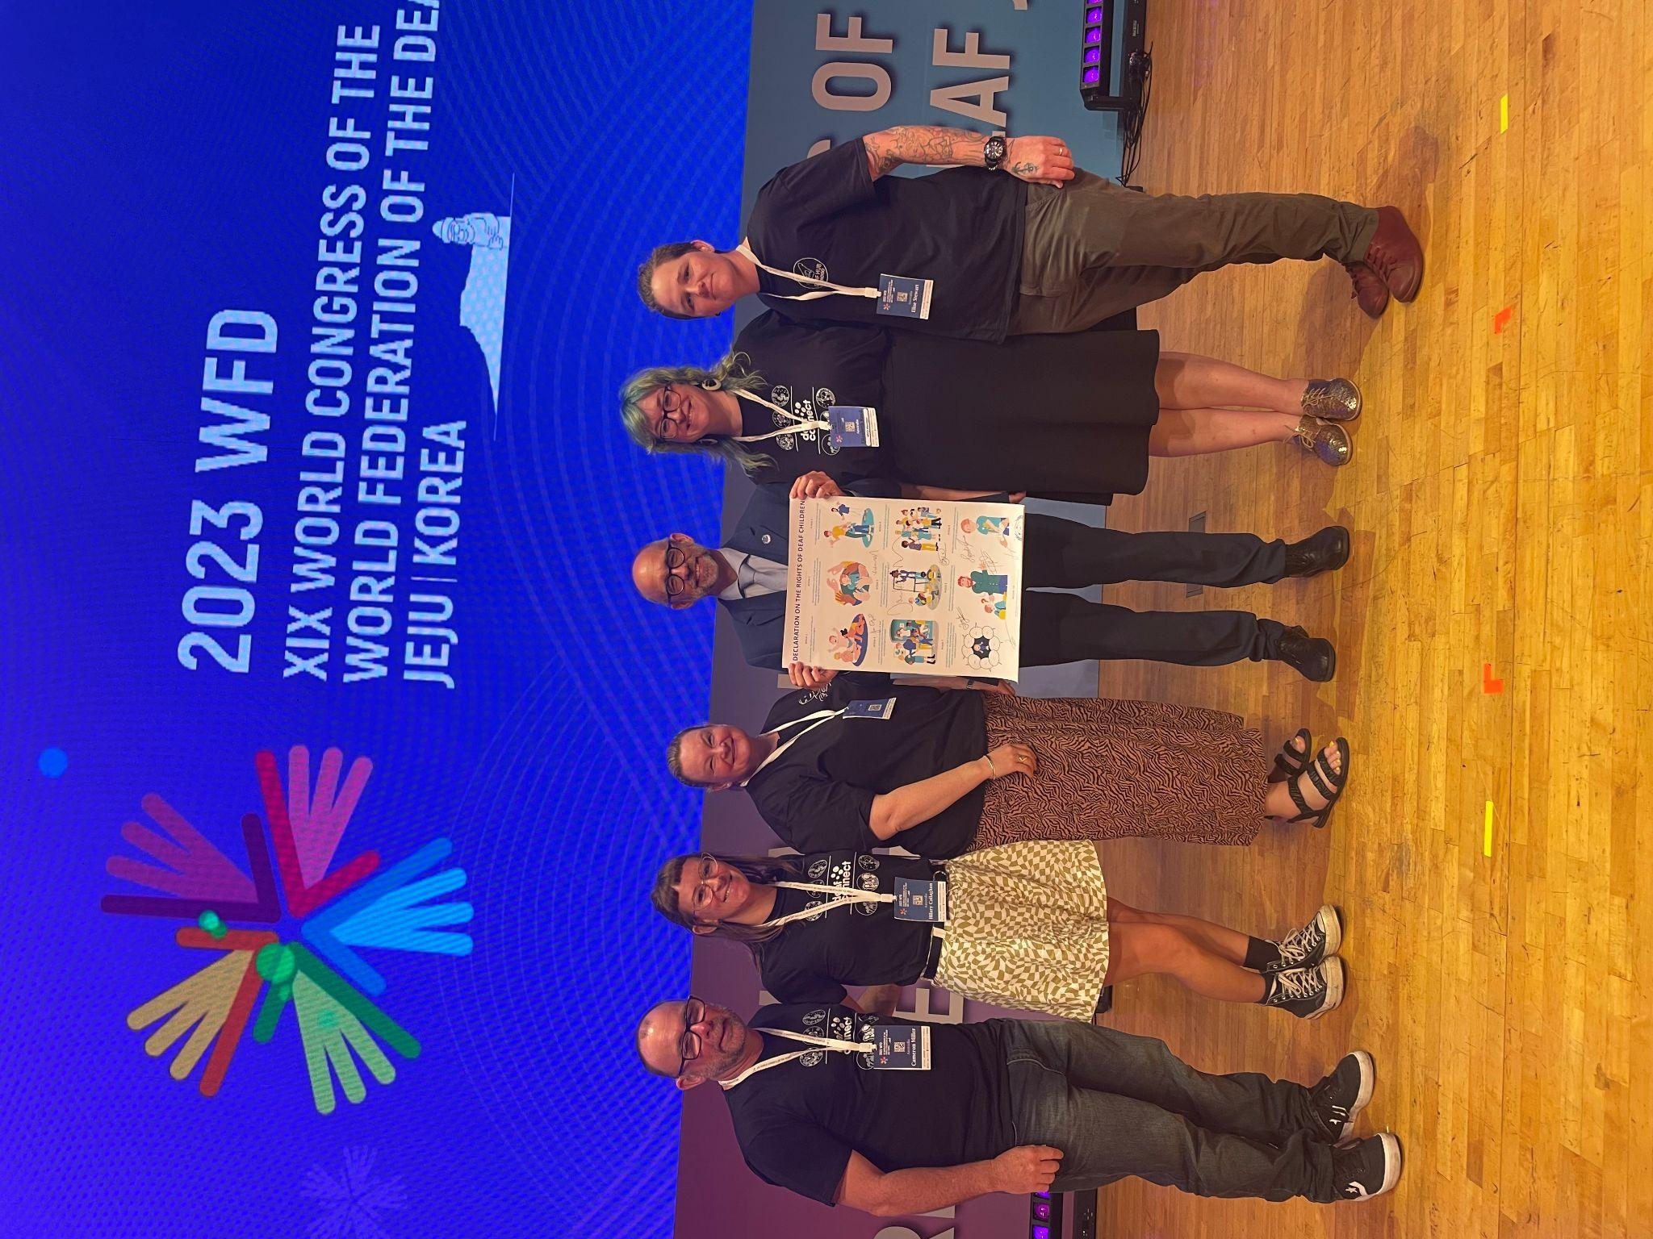
Notes:
The significance of this declaration - and it is open for signing today; if you go to WFD’s website, there is a video of Dr Joseph Murrary explaining the document in International Sign, and a link to signing it online.

Slide 20
What Next?
Notes:
How to utilise this document?
We are sharing this with our educational colleagues, both in our institutions and professional community. We are also in the process of appealing to the government for recognition of our advocacy, expertise and rights of deaf children. This specific declaration only happened two months ago so it is a relevantly recent news. WFD made this document to act as a tool for advocacy on a local, regional, national and international level, in response to the United Nations convention on the Rights of the Child. While this is not a legal document, WFD has been successful in international advocacy and empowering deaf members in advocating for changes in their respective countries.
There are lots of legal documents that could be used, on top of the Declaration on the Rights of Deaf Children, such as the Convention on the Rights of Persons with Disabilities (2016), The Convention on the Rights of the Child (1991), as well as the Disability Inclusion Act (2014) which focuses on schools and facilities. There are service providers that can support families who need extra support to advocate for their deaf child.

Slide 21
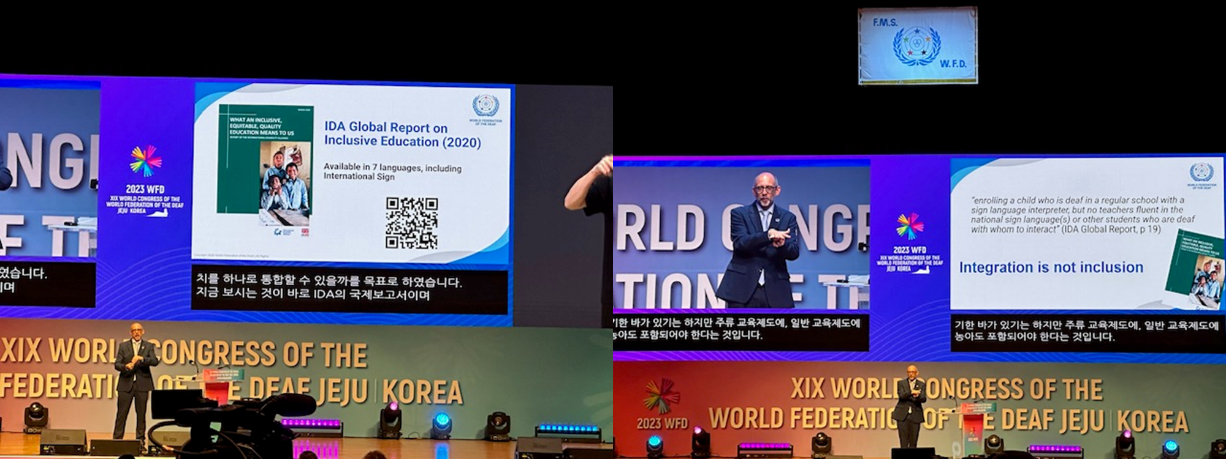
Notes:
One such legal document is the IDA Global Report on Inclusive Education (2020). It is evidence that integration is not inclusion, and the basis of WFD’s Declaration on the Rights of Deaf Children.

Slide 22
Q & A
Session

