Slide 1
20/20
Notes:
40 years old!
$ from DFFH for advocacy

Slide 2
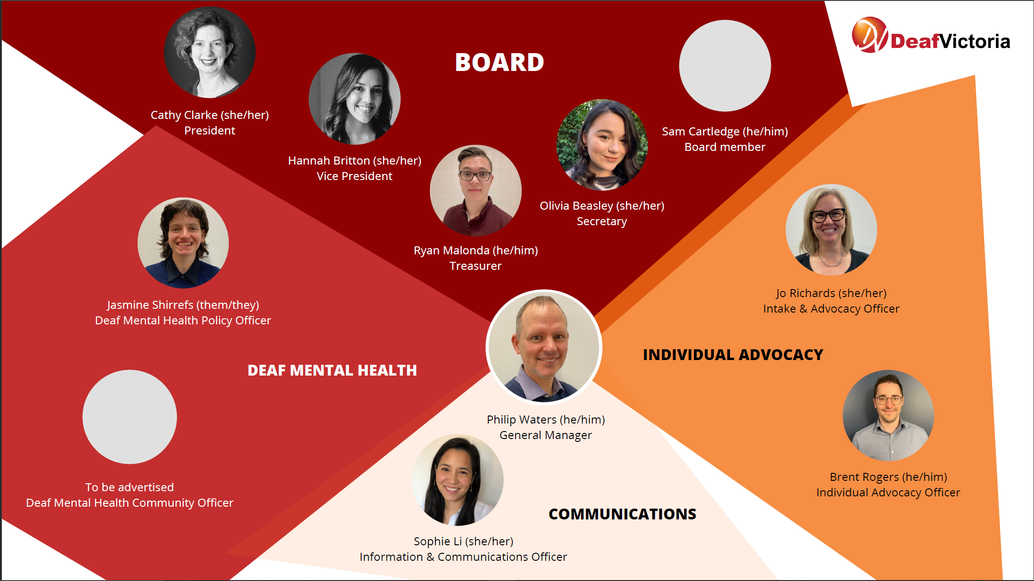
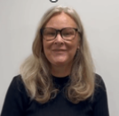
Deaf Victoria Board and Staff
Sandra Spadea
Notes:
Sam C missing.

Slide 3
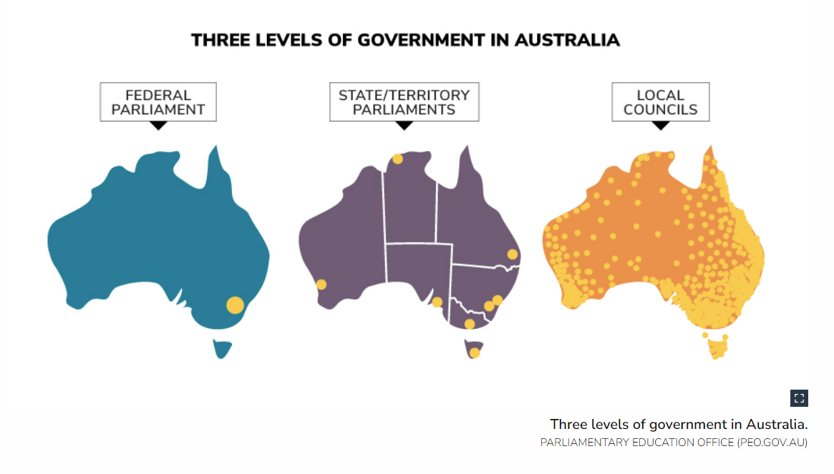
What is State based advocacy?
Notes:
Australia means ALL 3 in one but still separate
So, if have one state, means not same in other states

Slide 4
Deaf Australia and Deaf Victoria
Deaf Victoria
Deaf-led
Victorian focus
Work with Victorian Government on key areas:
Health & Mental Health
Education
Justice/police
Housing
Work with Victorian based Auslan interpreter agencies
Member of Deaf Australia
Deaf Australia:
Deaf-led
National peak organisation & World Federation of the Deaf member
Work with Commonwealth Government
Aged care
Auslan/interpreters
NDIS
Centrelink
EAF/Job Access
Runs Auslan Day, NWDP, Dot Shaw Writing competition, Colin Allen AM Lecture
Notes:
Any Vic or Aus areas can you think of?
COVID
Immigration
Transport
VEC / AEC

Slide 5
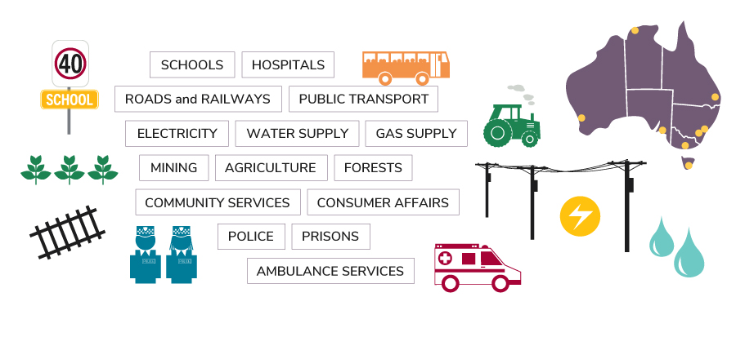
What is State based advocacy?

Slide 6
What we do - Individual advocacy
For advocacy or information, contact us:
info@deafvictoria.org.au
Notes:
Examples:
Mental Health
Hospital
Access to legal services (e.g. fencing/NDIS/family POA)
Neglected/ignored/discriminated
No interpreter provided
Family members control

Slide 7
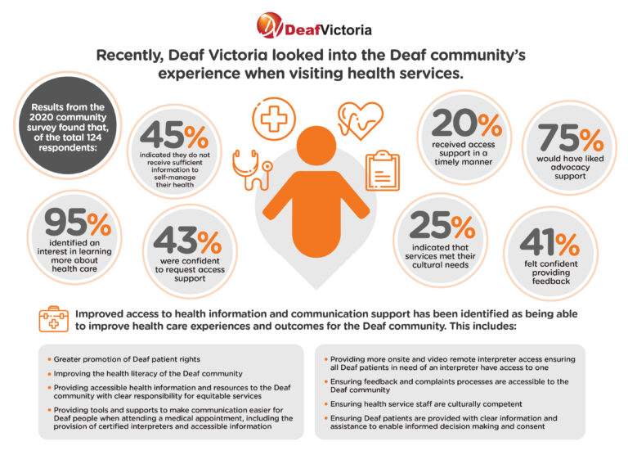
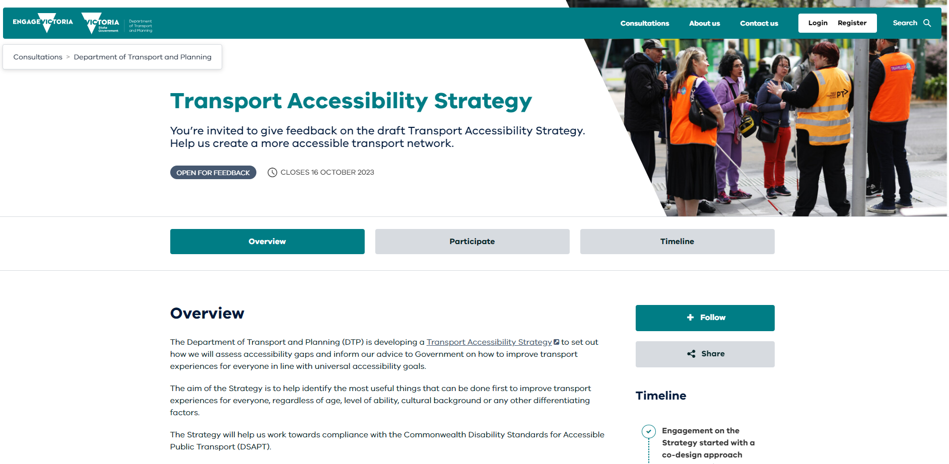
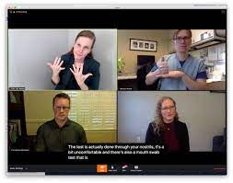
What we do - Systemic advocacy
Networks
Reports
Submissions
Advisory Groups
Meetings
Notes:
Examples:
Submissions: Others: MH and Disability Inclusion Bill
Reports: Hospital Accessibility
Advisory Groups: Disability Inclusion in school
Meetings: Hospital DLOs
Networks: DHH

Slide 8
What we DO and what we DONT
What does Deaf Victoria do?
Act as an advocate for ALL deaf and hard of hearing people helping them to make complaints - free
Provide neutral information about available services and supports
Develop and share resources about rights
Have relationships with Victorian Government and other organisations to promote the needs of the deaf and hard of hearing community.
Deaf Victoria does not:
Provide legal advice – We can refer you to appropriate services
Provide NDIS related services
Take over client cases
Make decisions for deaf people
Provide counselling
Provide interpreters or teach Auslan
Teach life skills, independence living or social skills.
Notes:
We do not call people we support ‘clients’ – we see them as deaf/hh people using our services

Slide 9
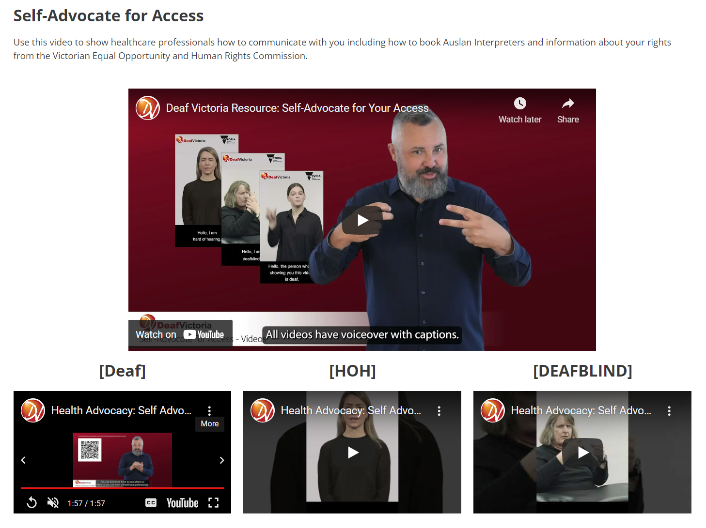
Resources
Screenshots taken from our website
Notes:
(We deal with applications for NDIS plan, appeals and AAT and we write support letters and evidence reports.
We deal with courts, ensuring the users accessibility, guide them through it, prep them for their hearing (if have communication barriers with English)
We deal with education, accessibility to Auslan and
We deal with justice, arranging legal advice or representation due to their barriers, discrimination a
We deal with employment workplace discrimination or barriers
We deal with healthcare due to barriers and discrimination, we write complaint letters
We deal with all ranges of areas and provide advocacy to achieve users’ goals or reach an agreement )

Slide 10
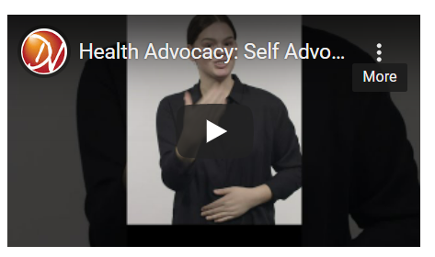
Example resource – Health video in Auslan

Slide 11
Thank You!
Notes:
Thank you! We look forward to continuing to work with you to improve access to quality healthcare for deaf patients.
Contact us via email to info@deafvictoria.org.au

